Slide 1

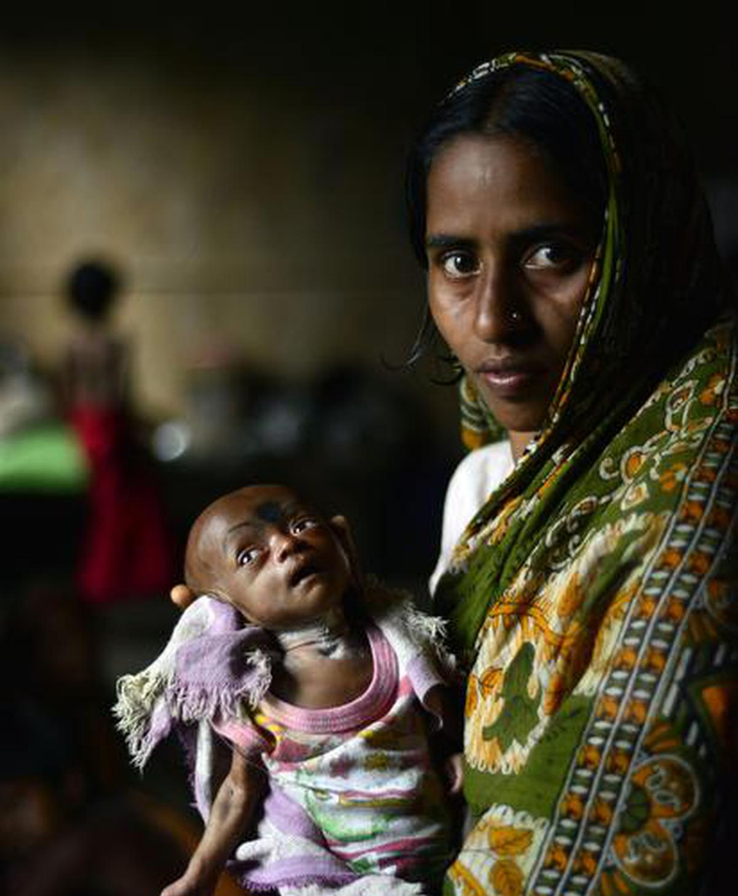
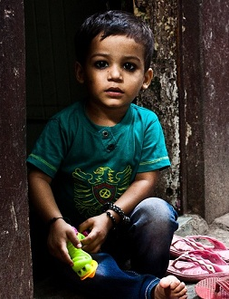
UNDER-FIVE MORTALITY: A GLOBAL CRISIS Botan Dolun Tabinda Hayat Saiful Islam Ashwini Shivaji Meher

Slide 2


MORTALITY RATE, UNDER-5 (PER 1,000)
Current health expenditure (% of GDP)
Out-of-pocket expenditure (% of current health expenditure)
Physicians (per 1,000 people)
Public spending on education, total (% of GDP)
Literacy rate, adult female (% of females ages 15 and above)
People practicing open defecation (% of population)
People using safely managed drinking water services (% of population).
Data Source: The World Bank

Slide 3
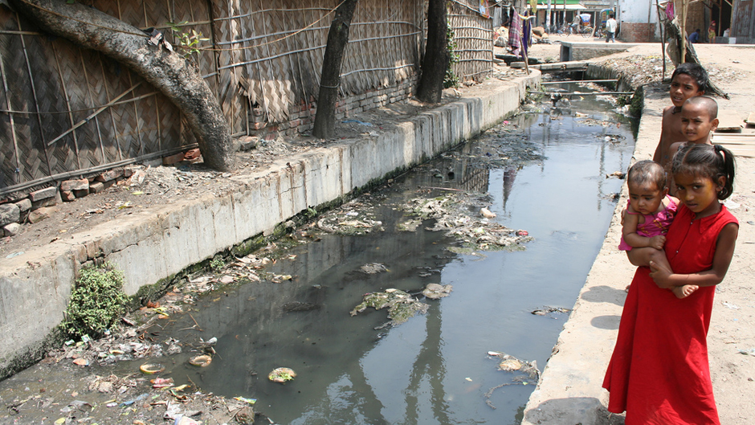
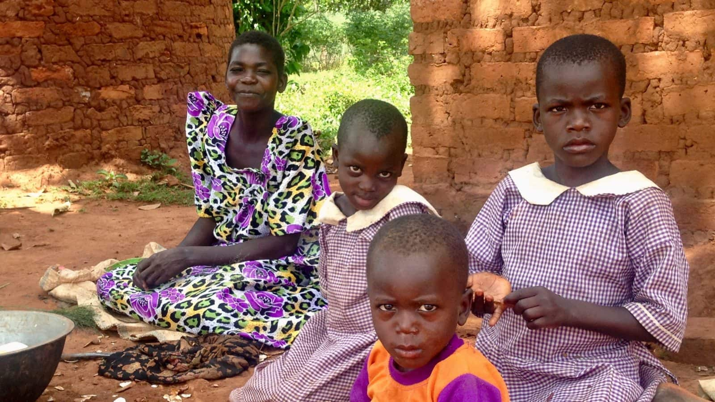
When the resources are limited, what should be prioritized, education or health care?
How important is mother’s education?
What is the role of sanitary practices and having access to clean water?
How important is universal health care?
How do continents differ with respect to these parameters?

Slide 4
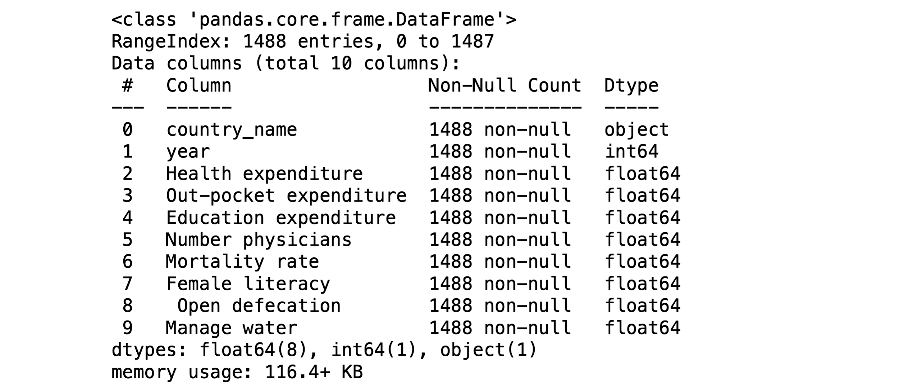
World Bank Global Mortality Rate Dataset (1950 – 2022)
Columns
- Response value: Mortality Rate

Slide 5
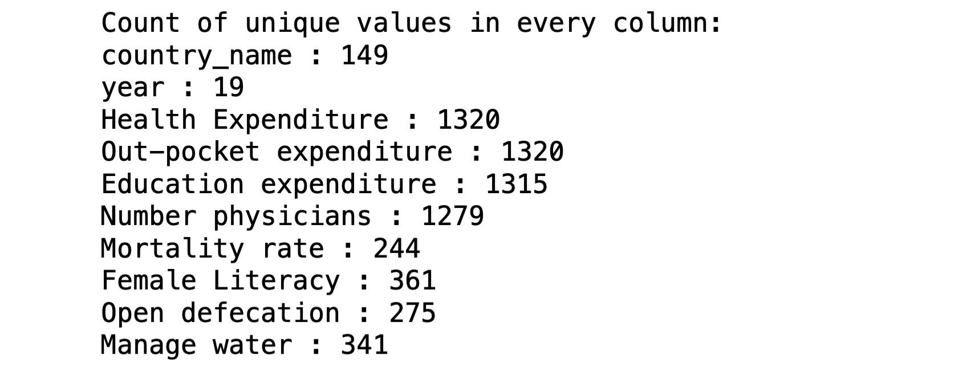
DATASET OVERVIEW

Slide 6
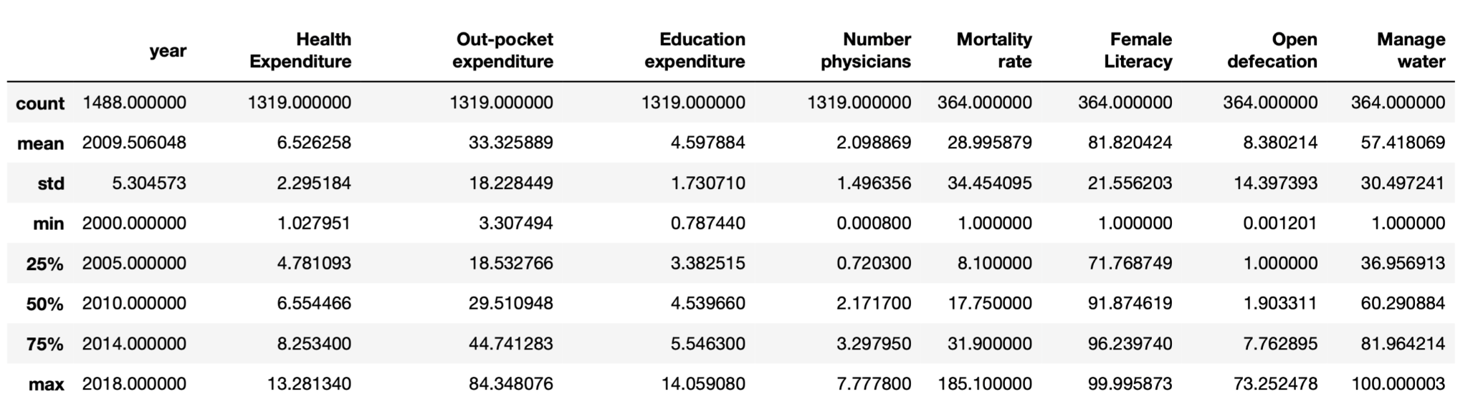
DATASET OVERVIEW
Summary

Slide 7
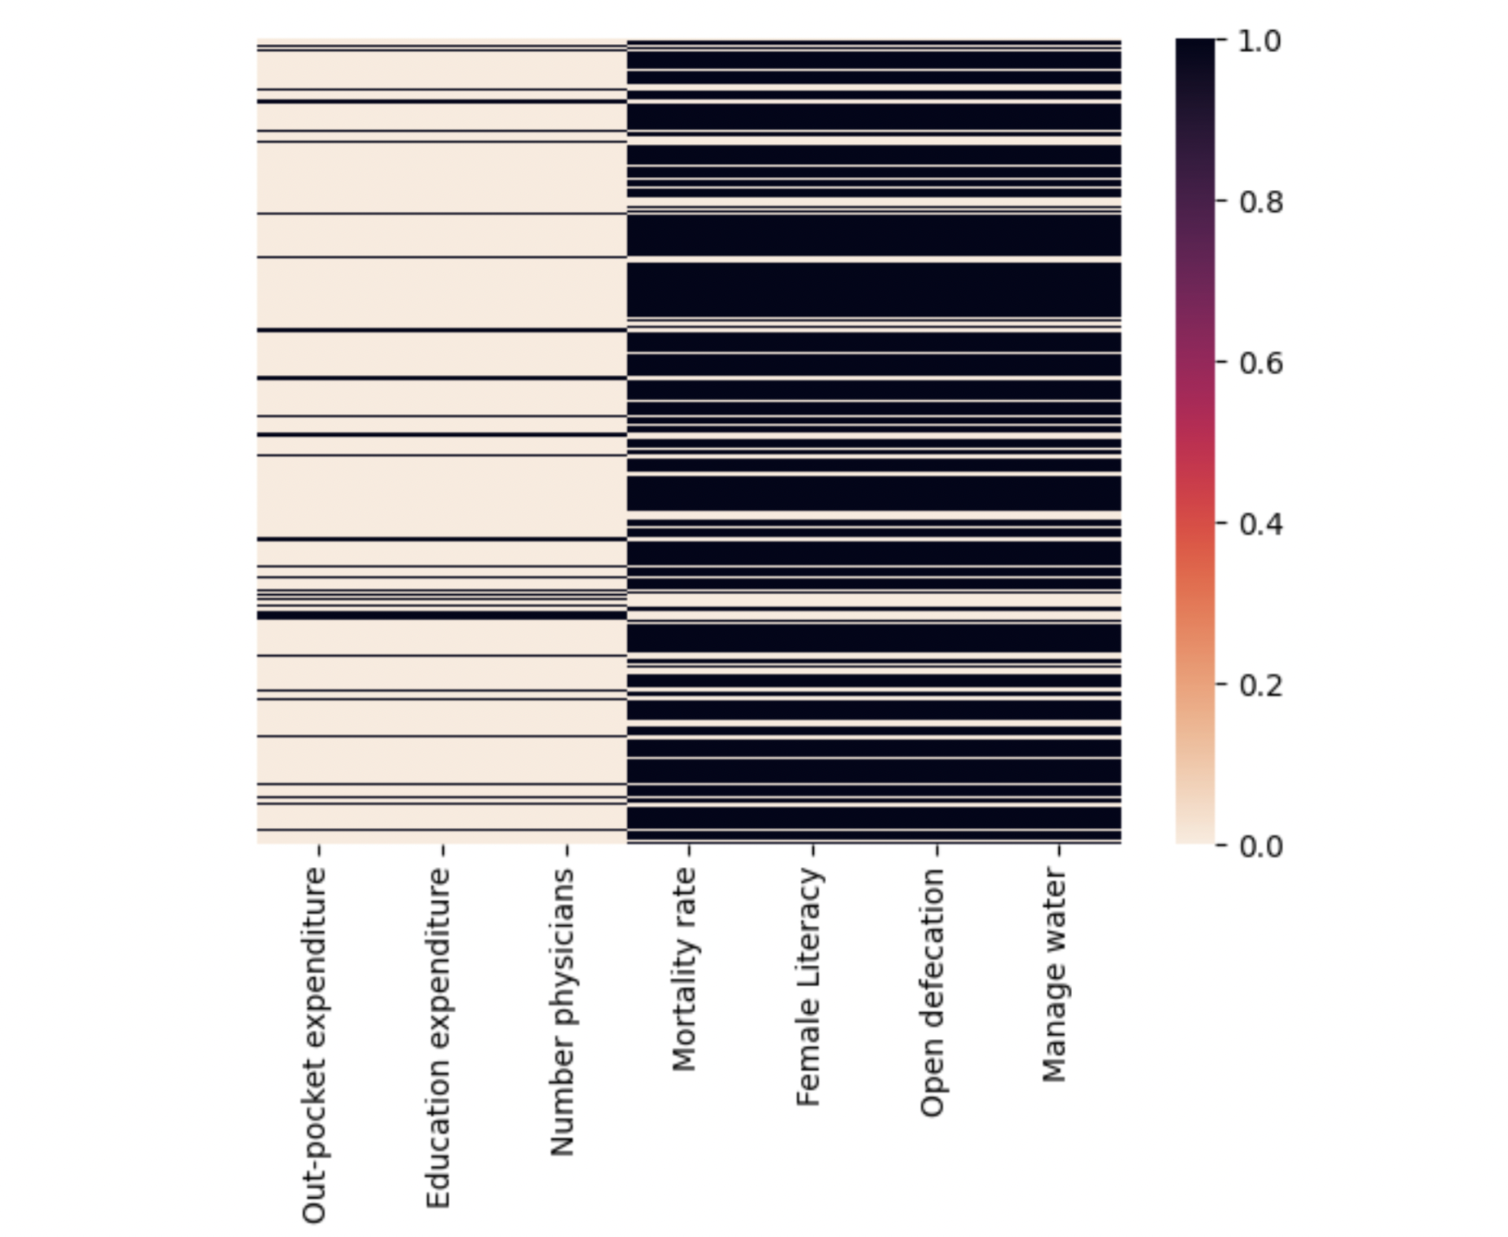
EXPLORATORY DATA ANALYSIS
Heat map demonstrating missing values

Slide 8
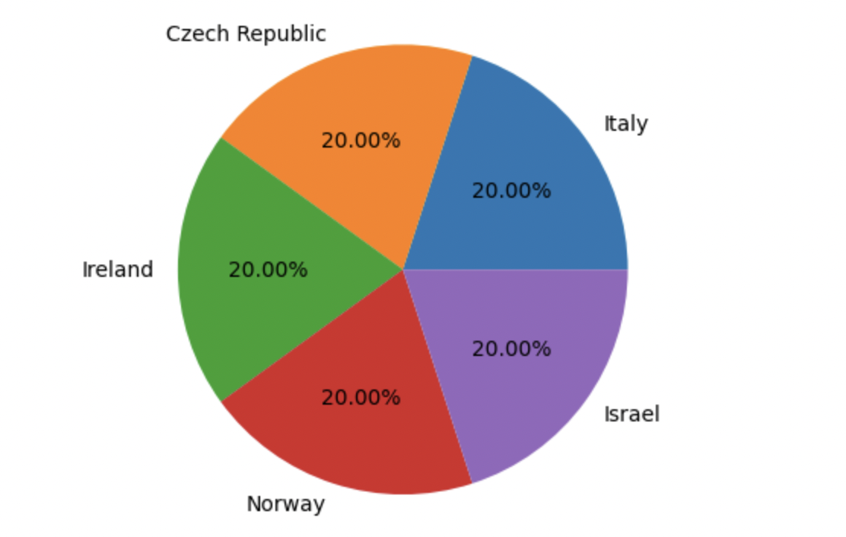
EXPLORATORY DATA ANALYSIS
Country wise record count (Top and bottom) Top 5 countries with maximum records
Italy : 19
Czech Republic : 19
Ireland : 19
Norway : 19
Israel : 19
Spain : 19
Iceland : 19
Austria : 18
Azerbaijan : 18
Singapore : 18
Lithuania : 18
United Kingdom : 18
-----------------------
Turkmenistan : 2
Mauritania : 2
Montenegro : 2
Dominica : 1
Eritrea : 1
Antigua and Barbuda : 1
Angola : 1

Slide 9
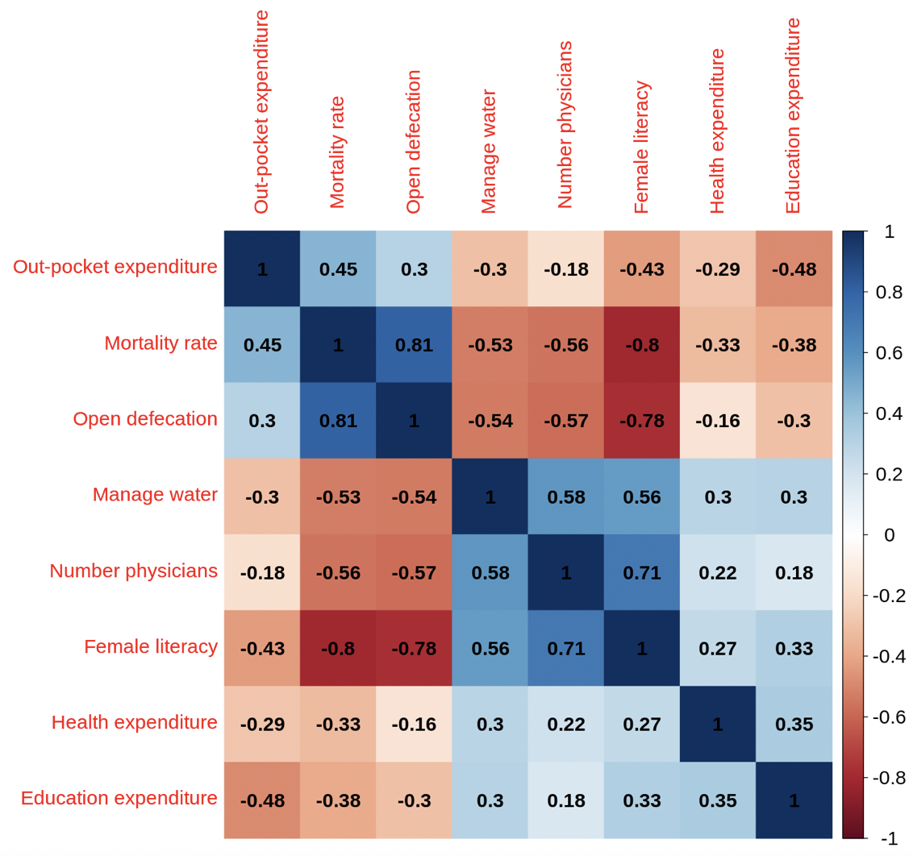
EXPLORATORY DATA ANALYSIS
Correlation Matrix
(All Data)

Slide 10
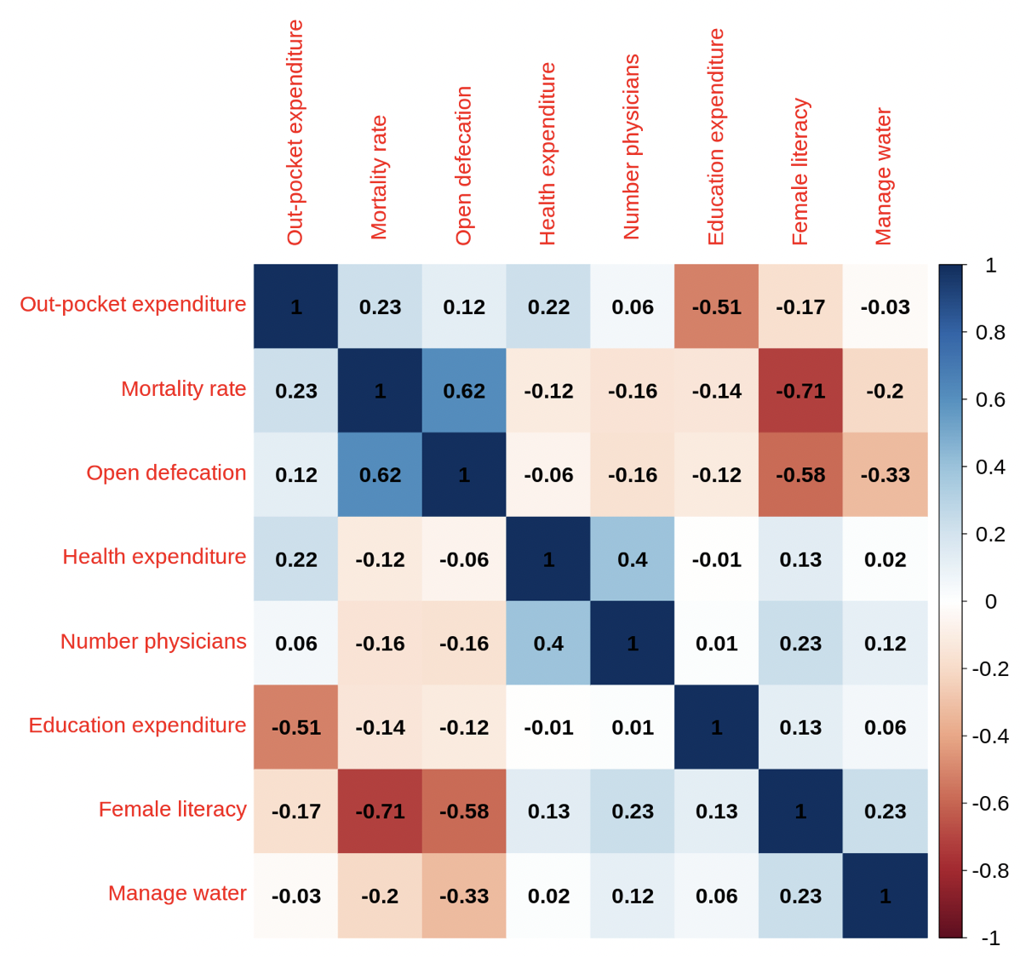
Continent: Asia

Slide 11
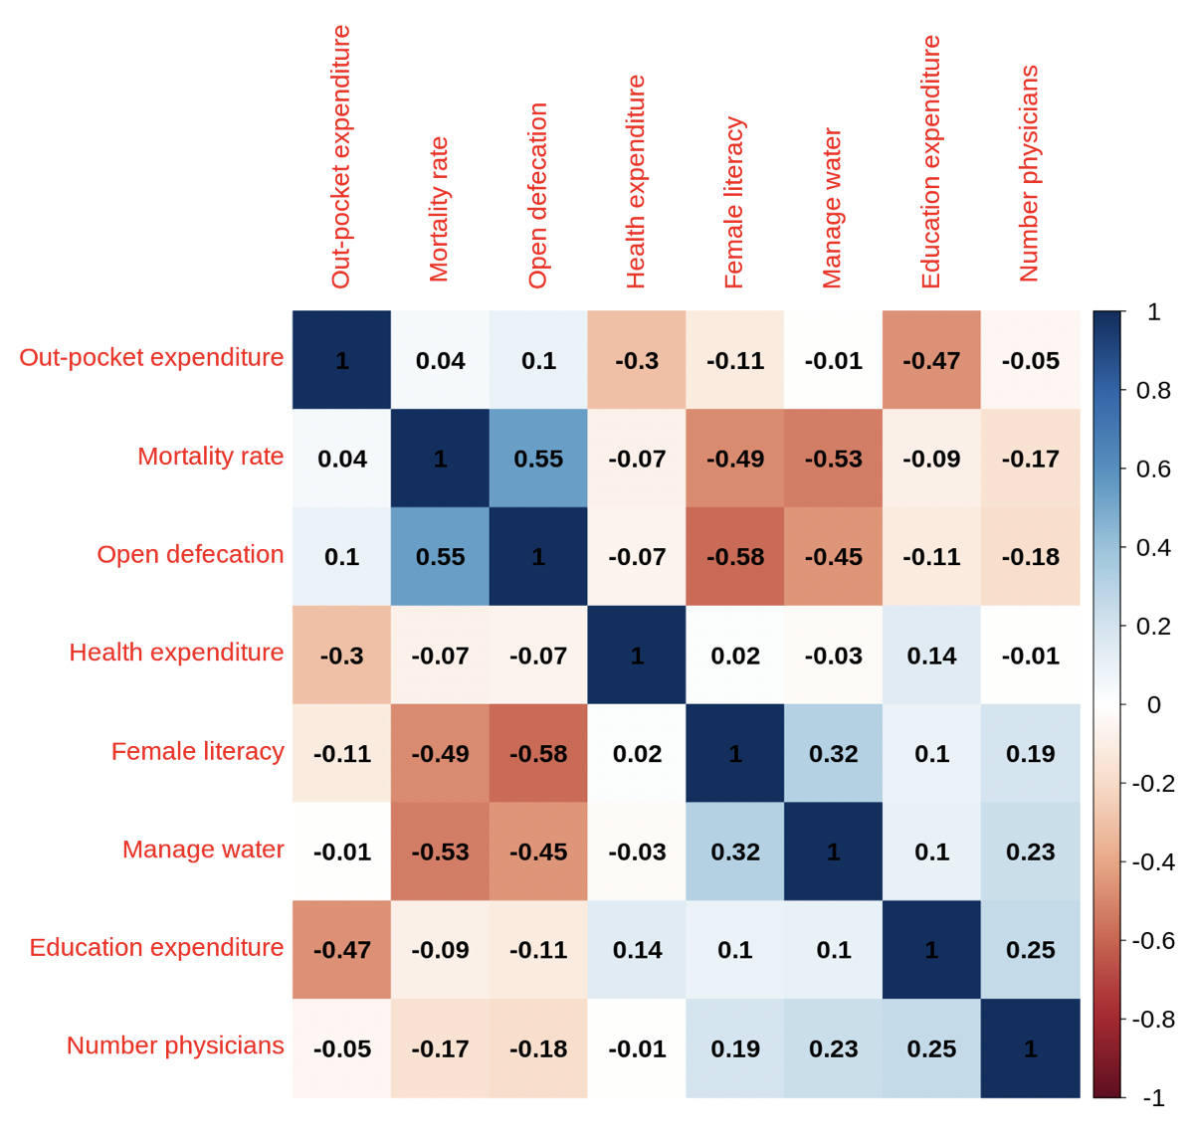
Continent: Africa

Slide 12
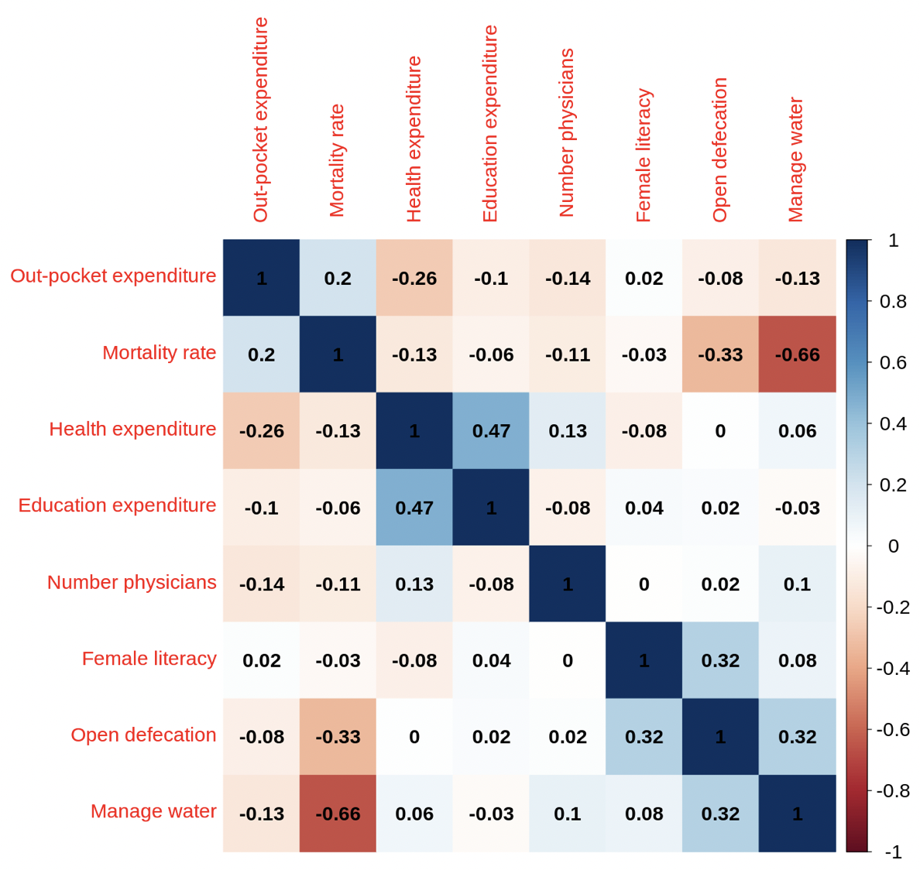
Continent: Europe

Slide 13
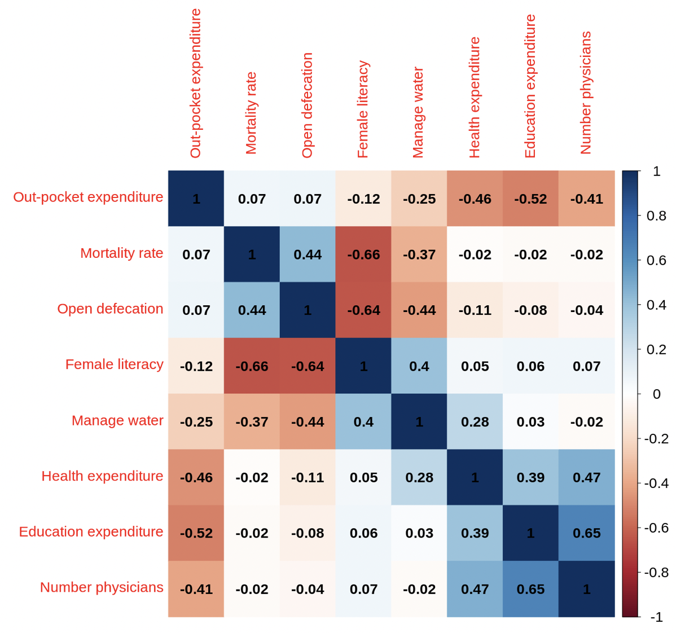
Americas
(North & South)

Slide 14
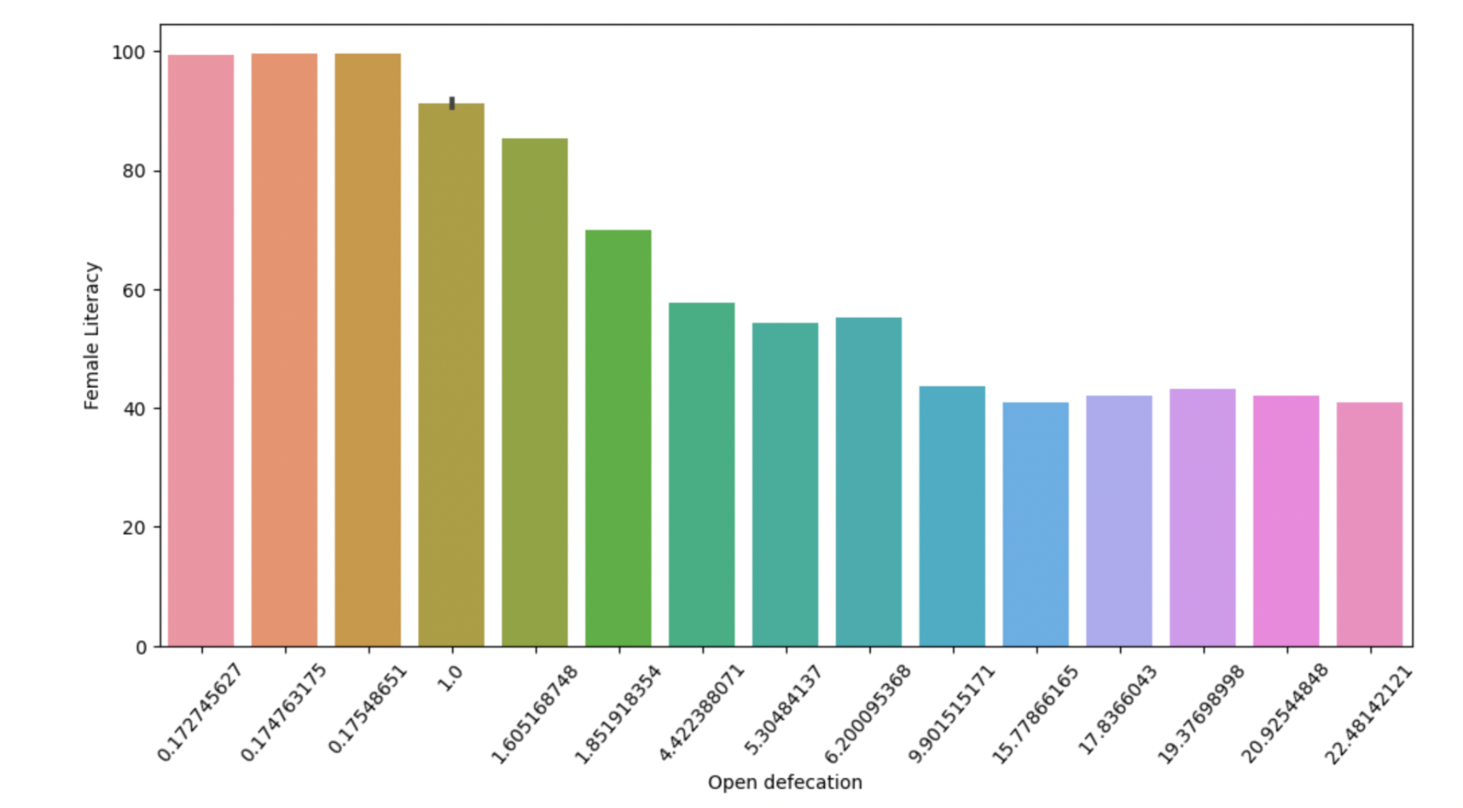
EXPLORATORY DATA ANALYSIS-change labels
Relationship between Literacy Rate among adult females and percentage of people practicing open defecation

Slide 15
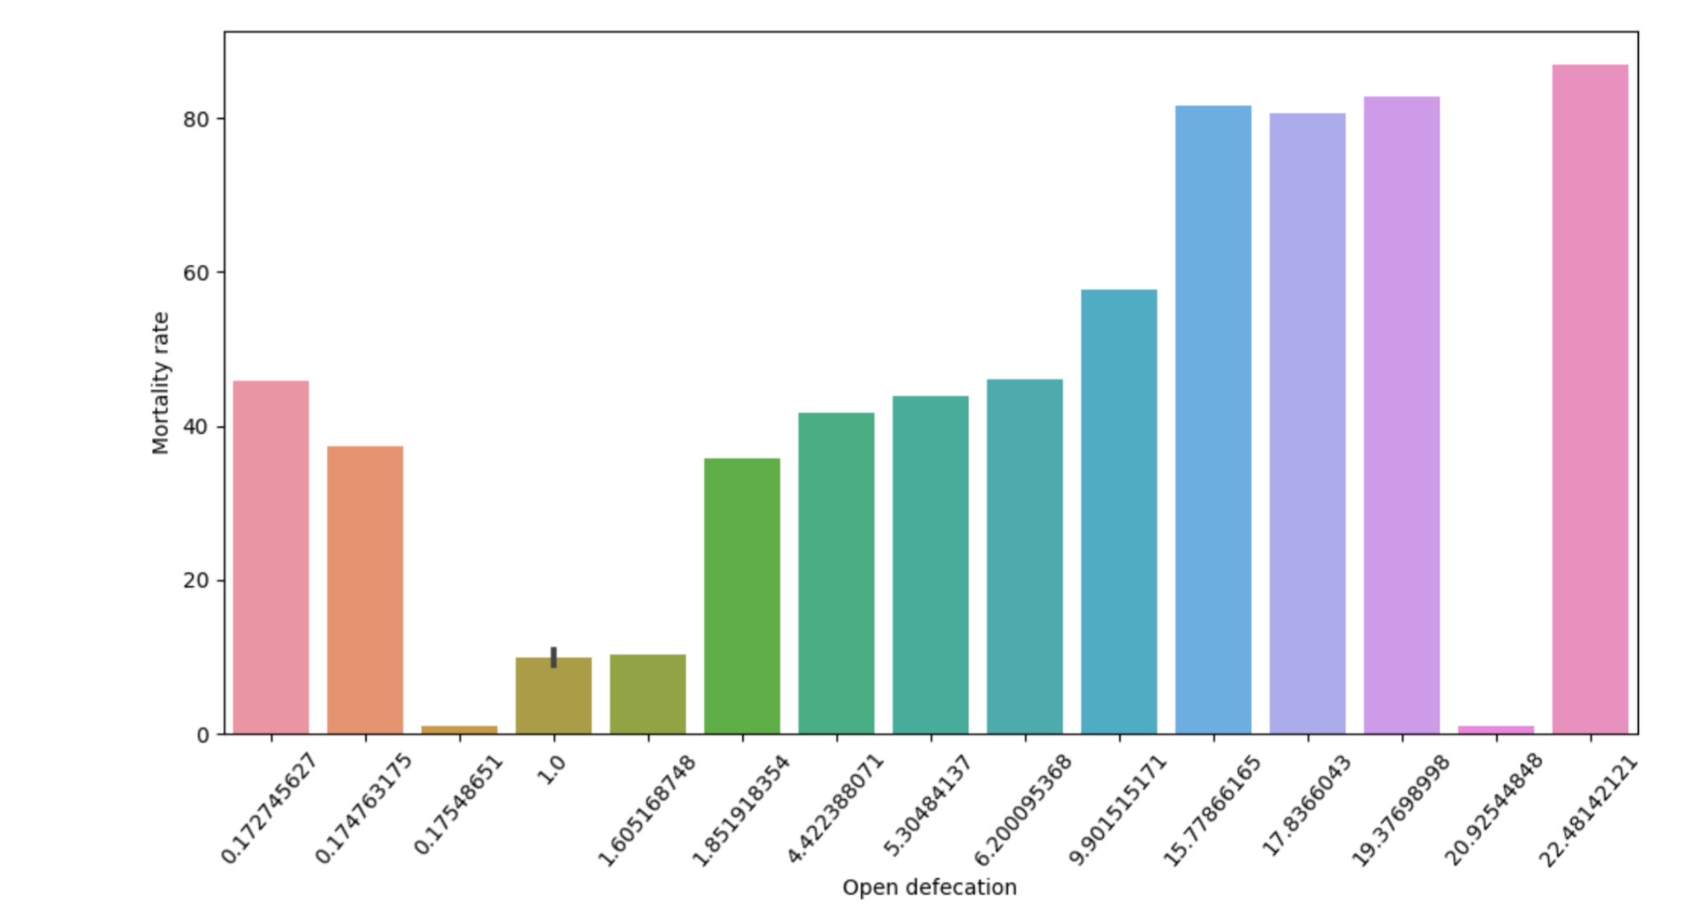
EXPLORATORY DATA ANALYSIS
Relationship between Mortality Rate and percentage of people practicing open defecation

Slide 16
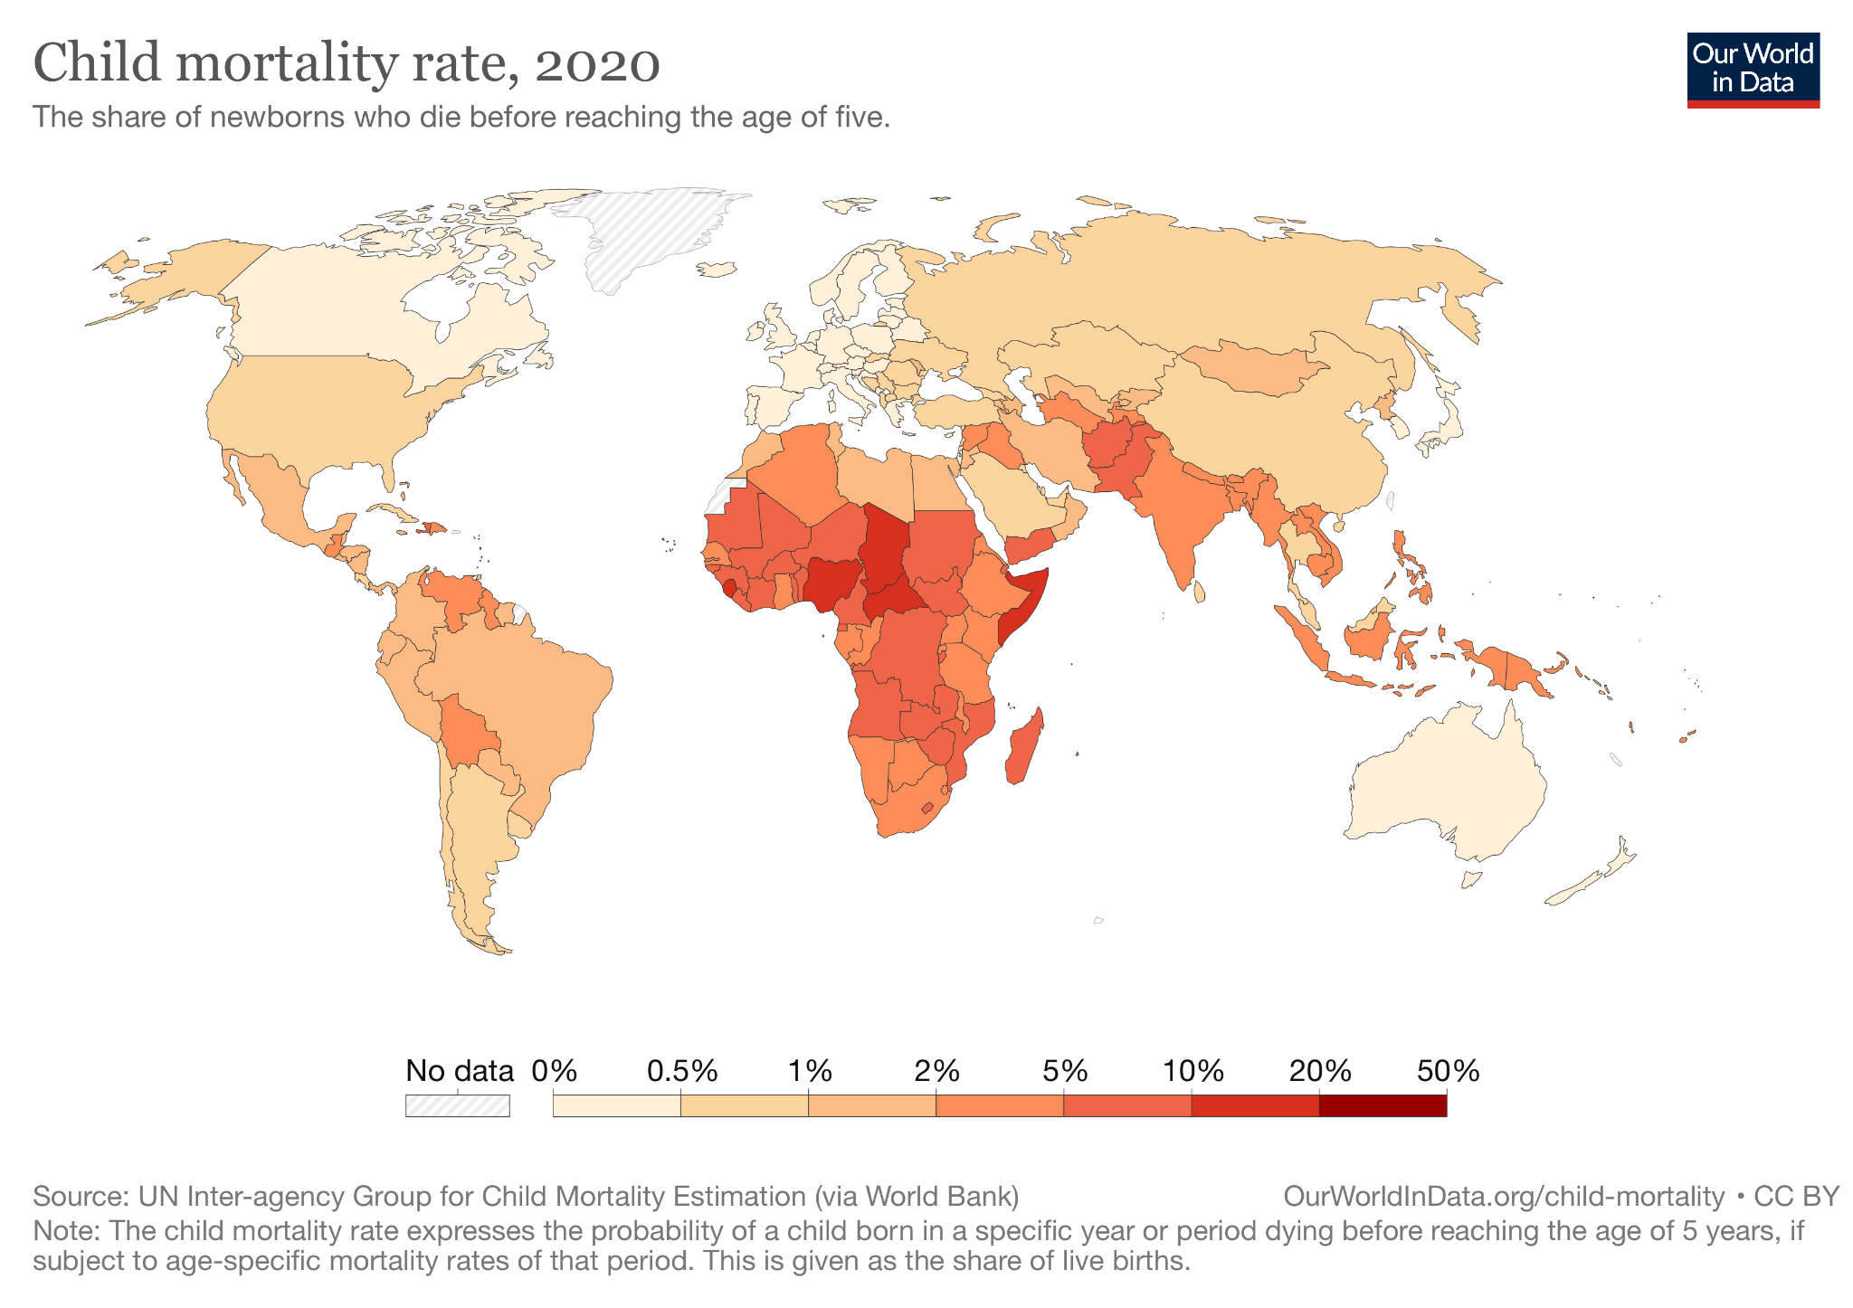

Slide 17
Methods
Multiple Linear Regression
Random Forest Regression
Support Vector Regression

Slide 18
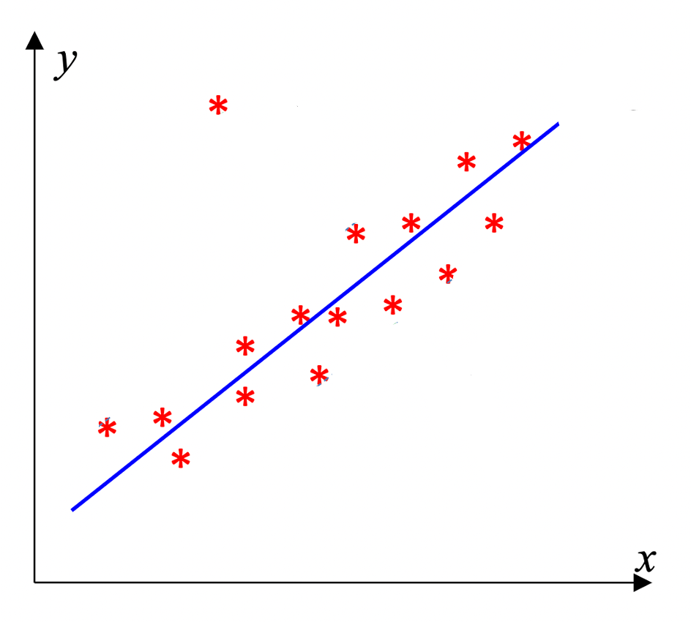
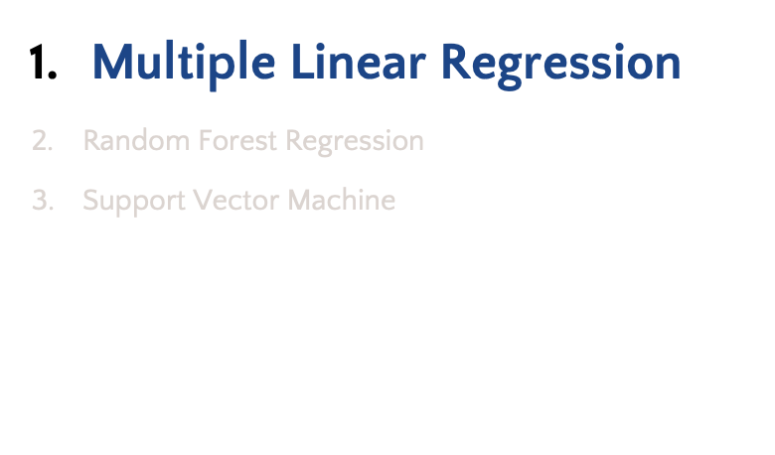
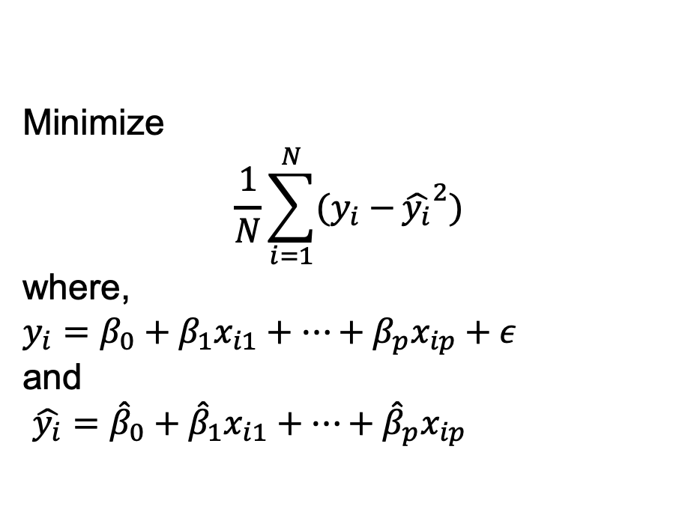
Methods

Slide 19
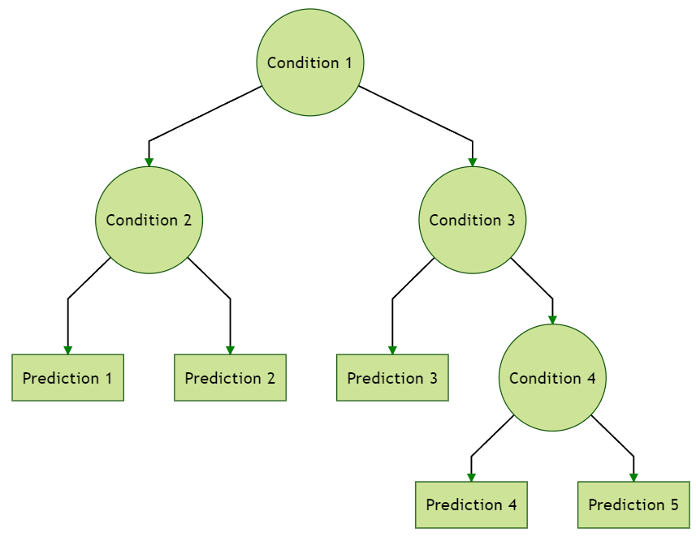
Methods
Multiple Linear Regression
Random Forest Regression
Support Vector Machine

Slide 20
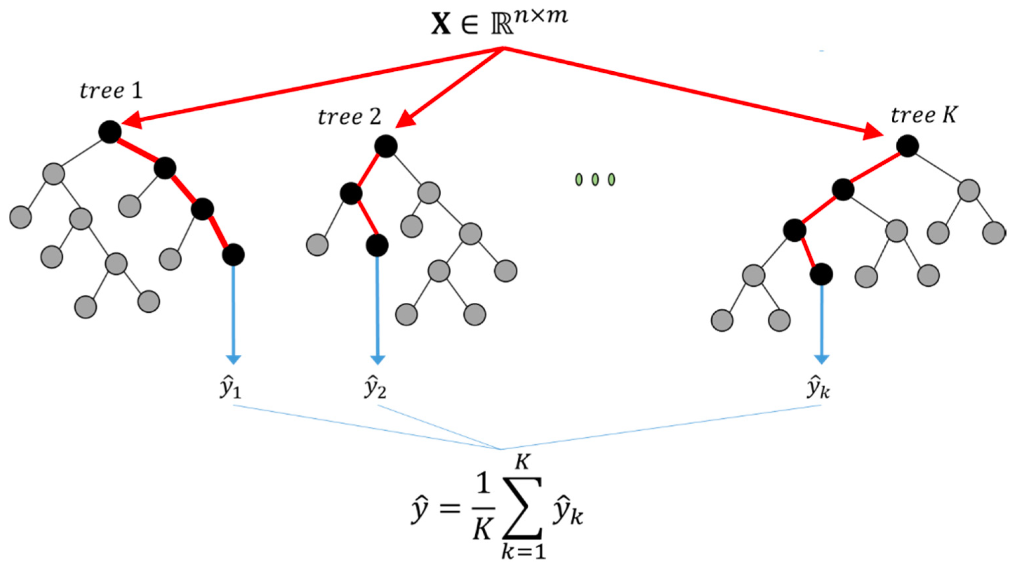
Methods
Multiple Linear Regression
Random Forest Regression
Support Vector Machine

Slide 21
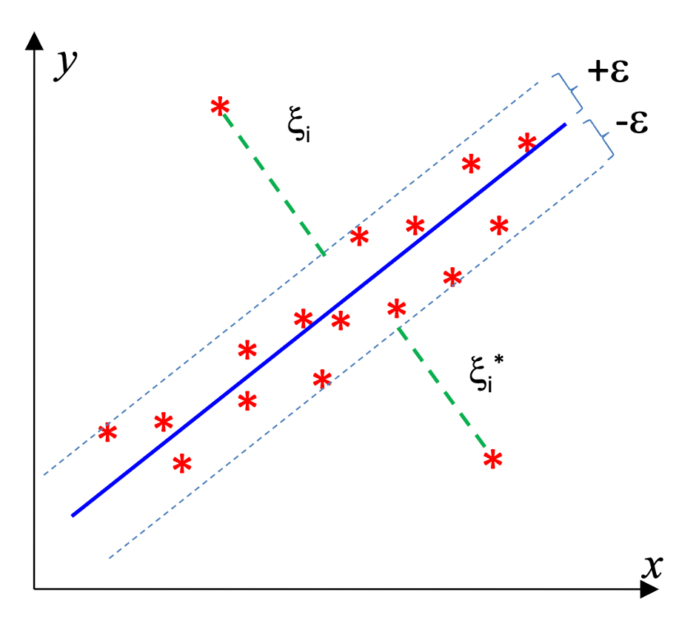
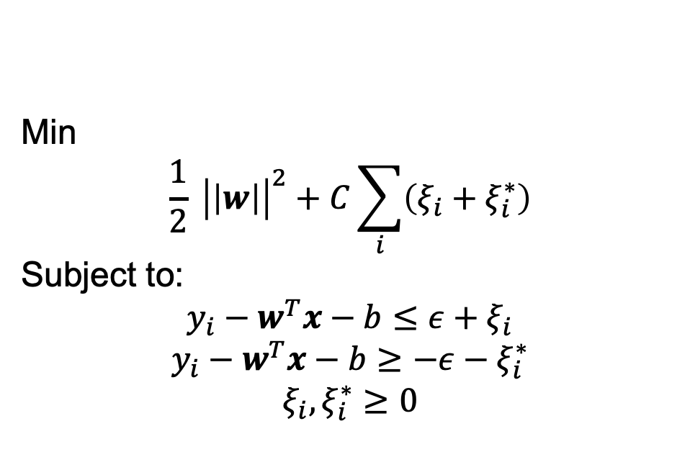
Methods
Multiple Linear Regression
Random Forest Regression
Support Vector Regression

Slide 22
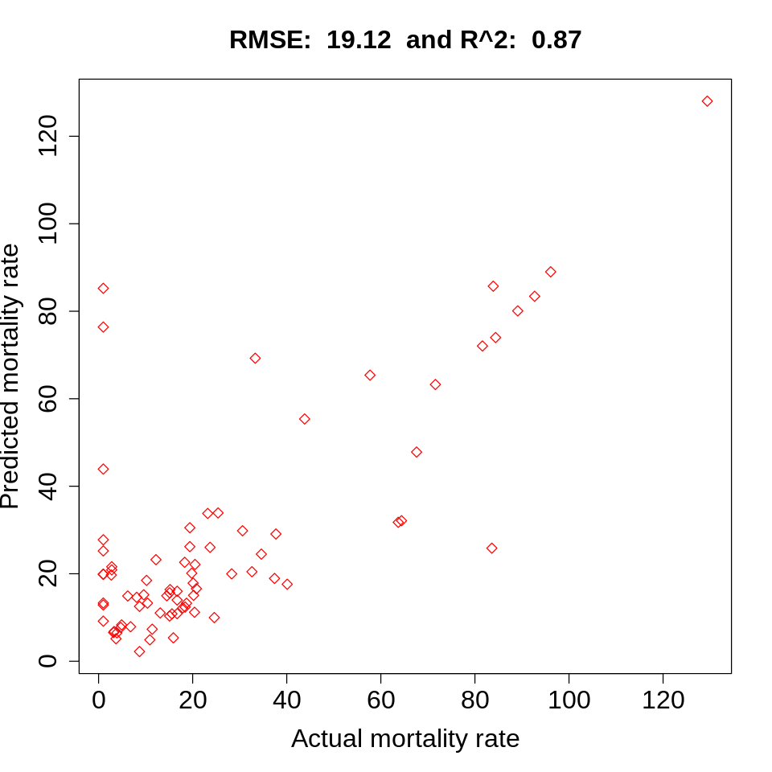
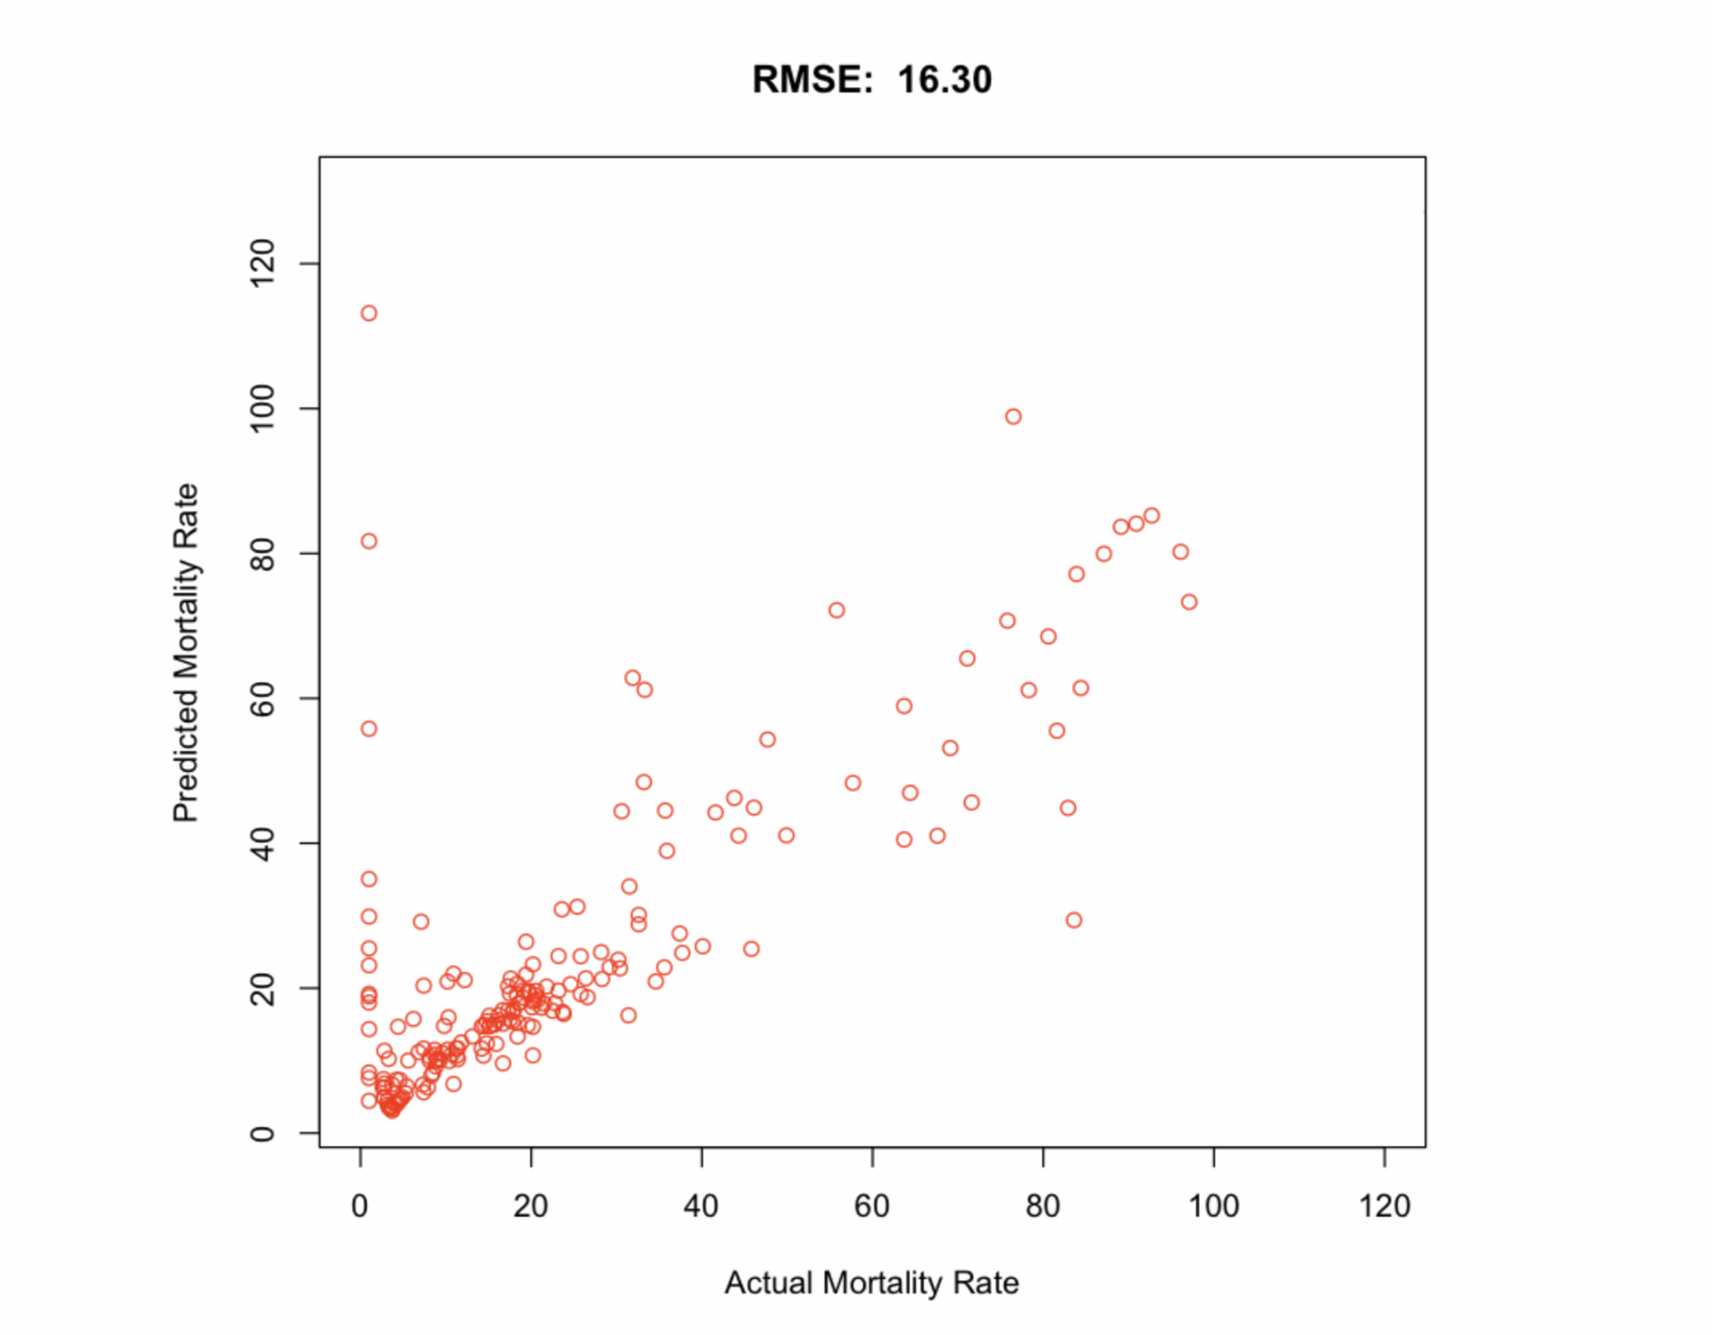
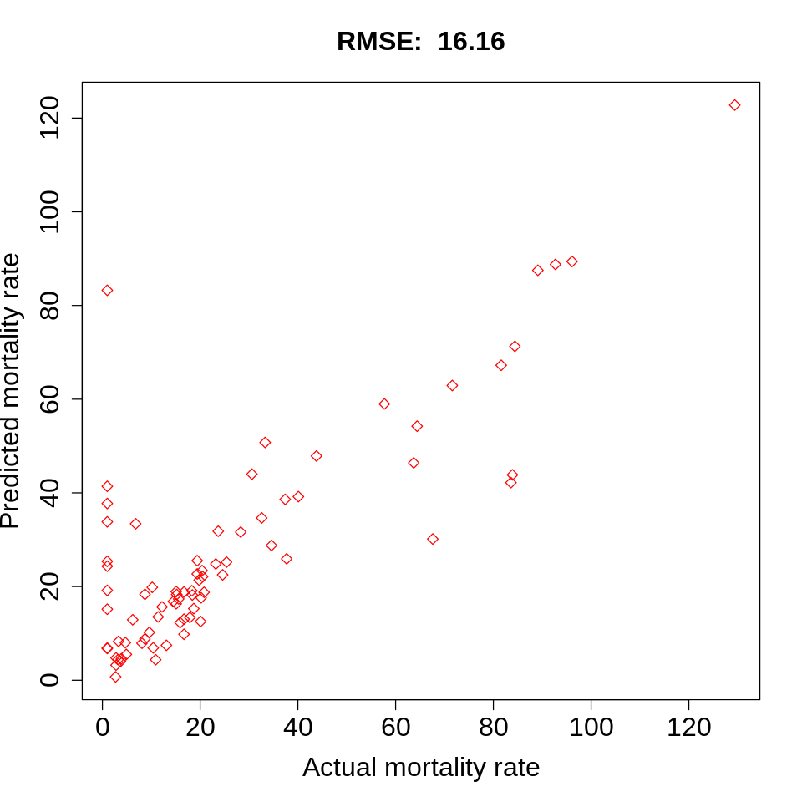
Results by Methods
Multiple Linear Regression
Random Forest
Support Vector Regressor

Slide 23
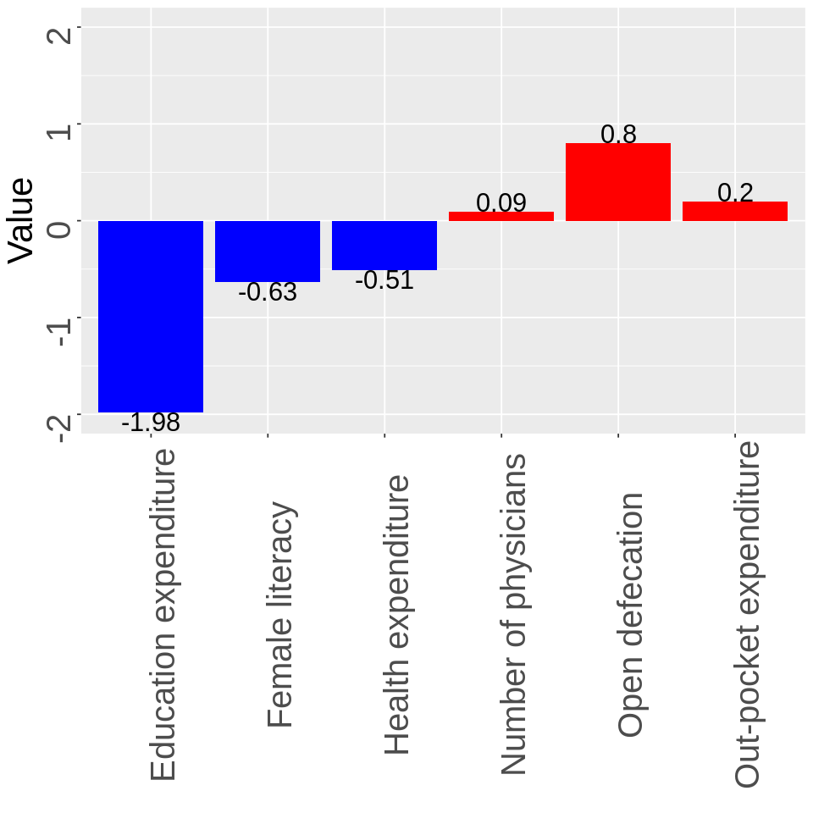
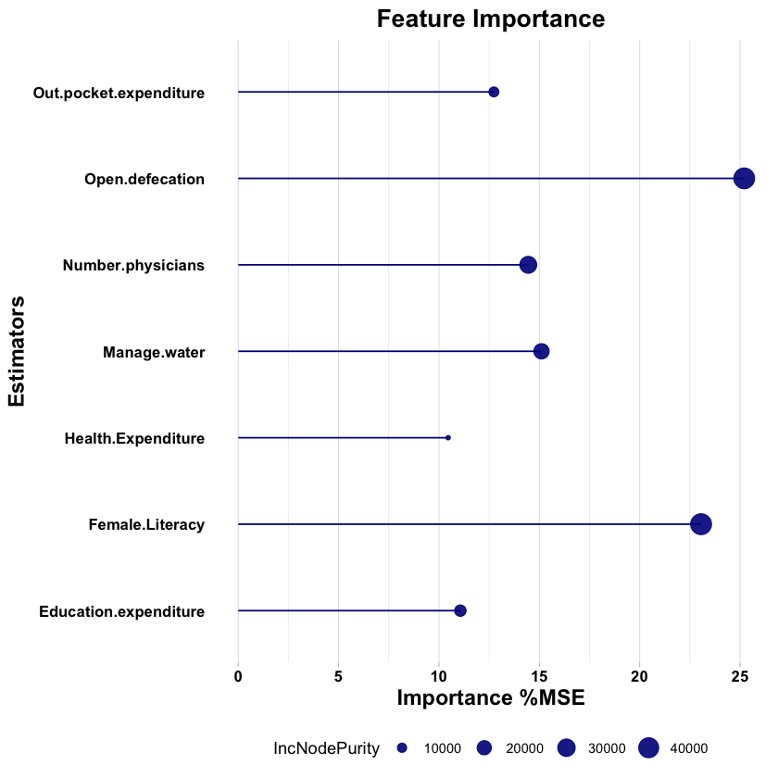
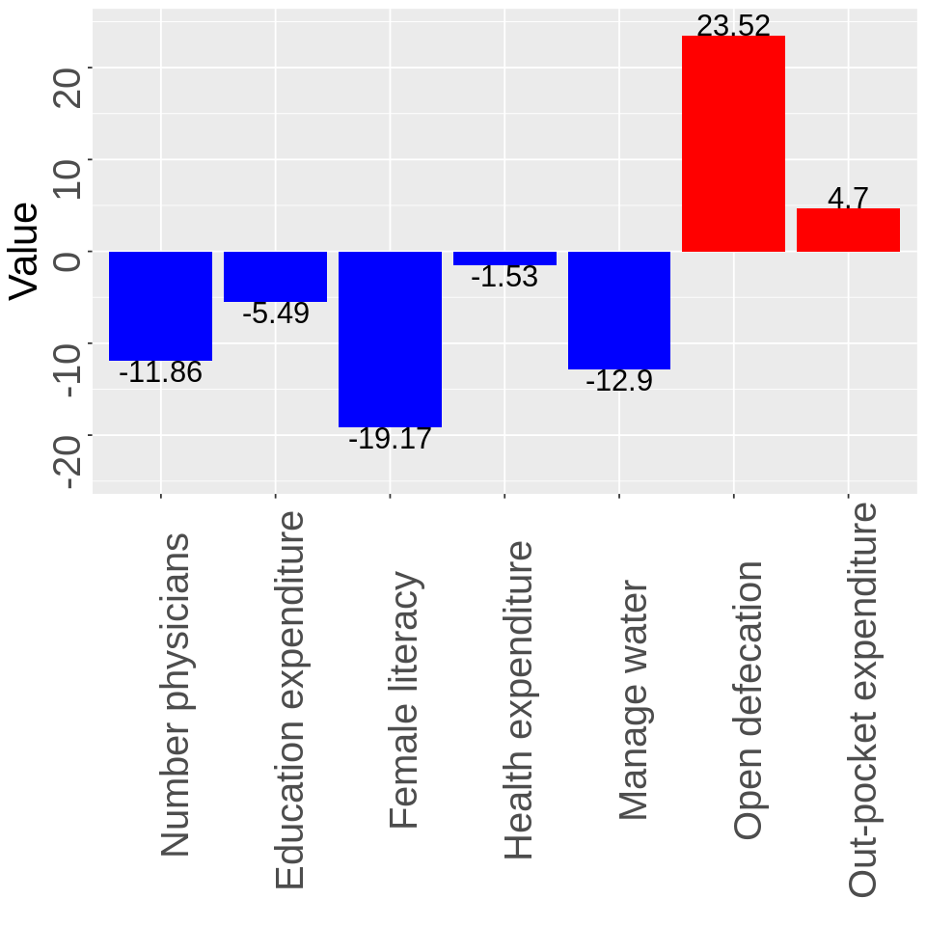
Results by Methods
MLR
SVR
Random Forest

Slide 24
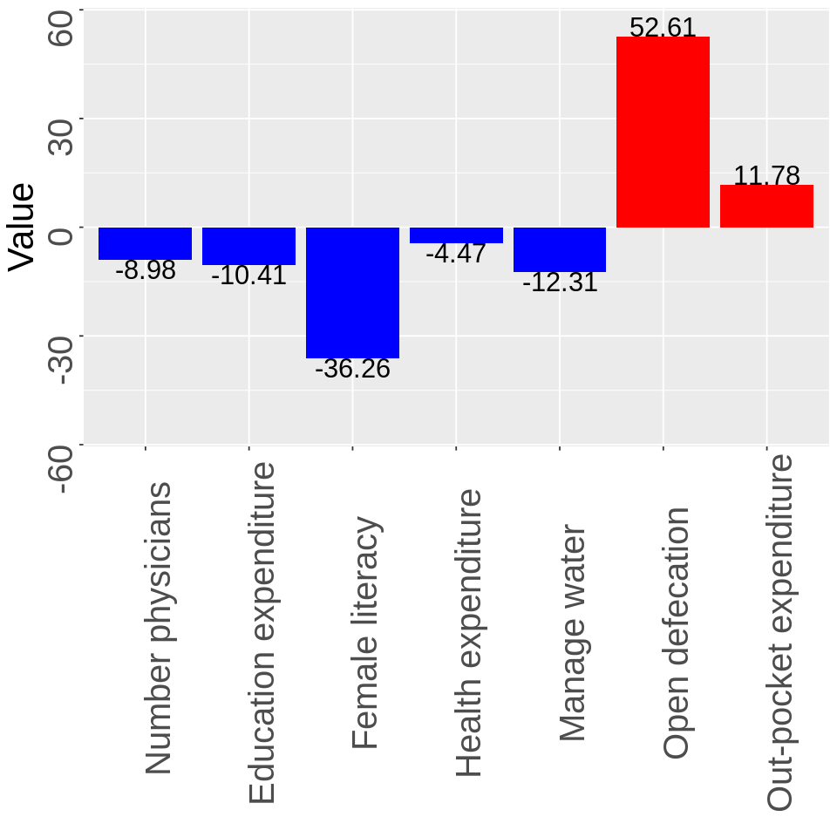
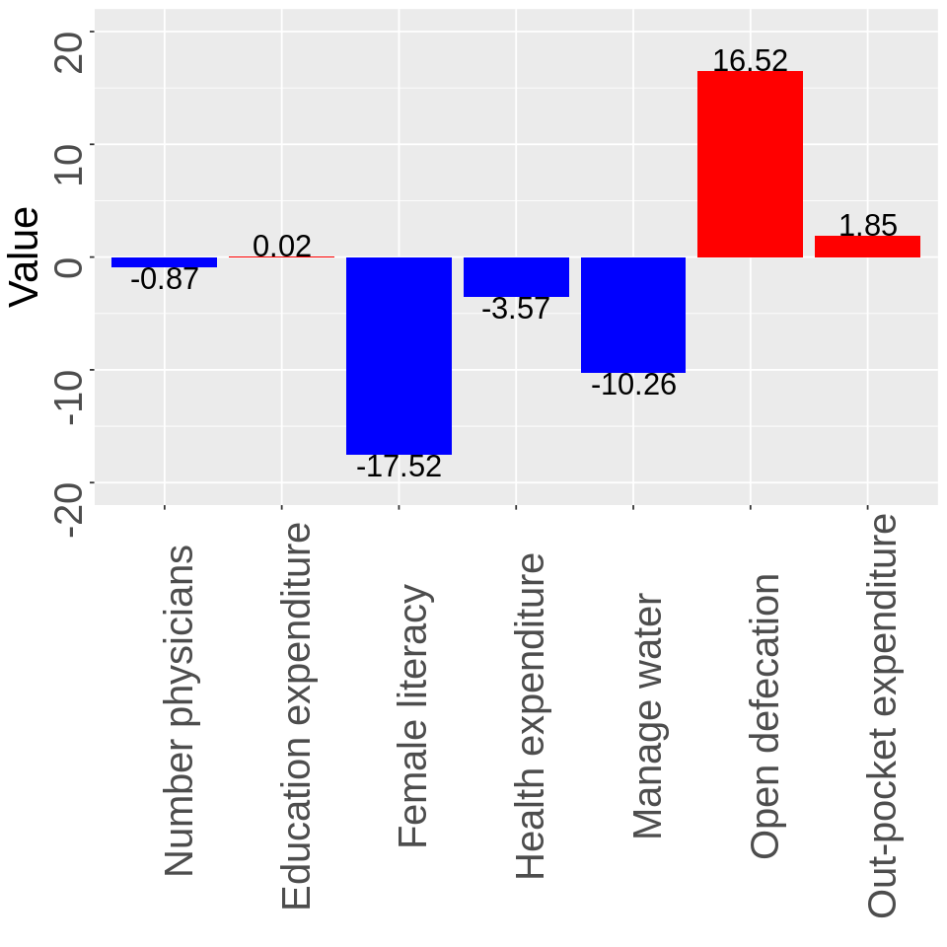
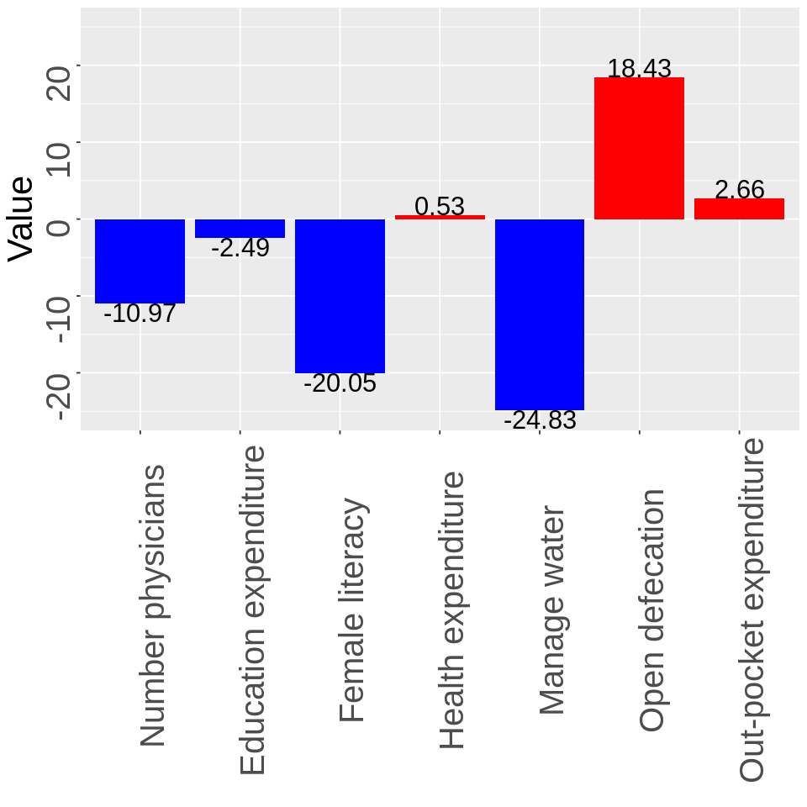
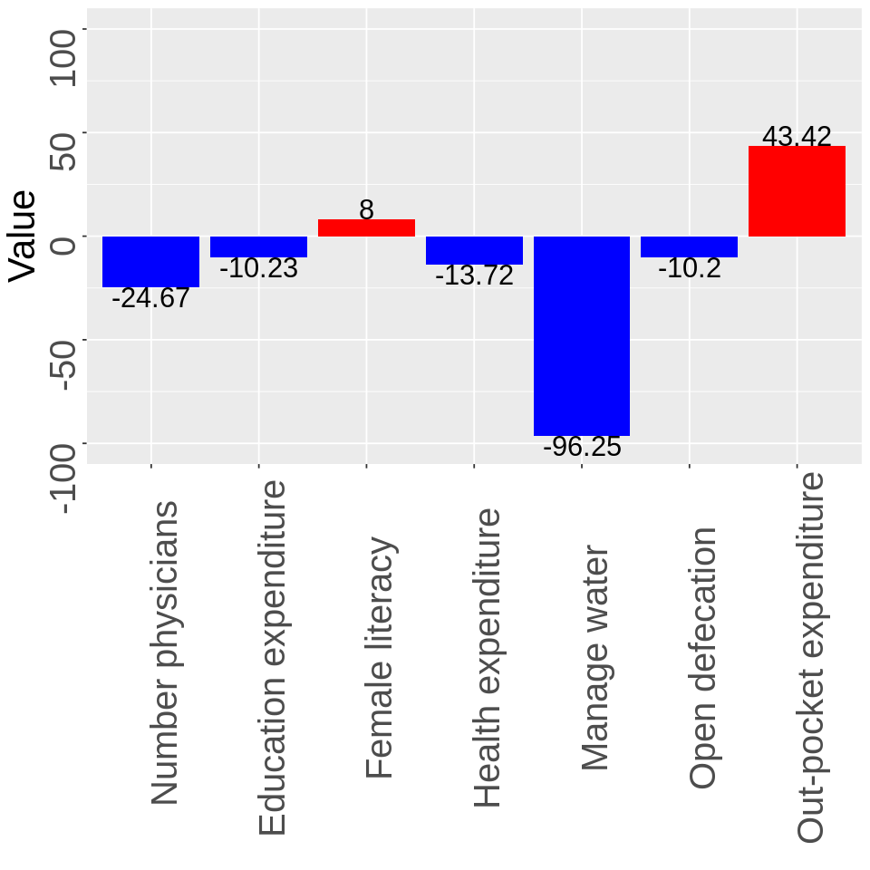
Comparison
of
Continents
Asia
Americas
Africa
Europe

Slide 25
Summary
Influence of different factors on child mortality rate varies in different continents.
Mortality rate under five years old is strongly (positively) correlated with literacy rate of adult females.
Mortality rate under five years old is highly negatively affected by open defecation.
Since healthcare is privatized, largely over the continents, the analysis suggests that investment in education (to increasing awareness) can help curb mortality rate better as compared to direct investment in the healthcare.
Given the data and the results from the findings, appropriate nutrition and access to clean water are also pivotal factors affecting the mortality rate in certain continents.
Child mortality is a vital indicator of child health and overall national development. Our analysis suggests that educational programs and public health interventions focused on birth spacing may turn out to be the most effective.

Slide 26

Thank you!

